Slide 1


Framework for Analyzing
Party Voting Patterns among Twitter Users
Based On Sentiment Prediction Results
Using BERT Architecture
Kantima Techaphonprasit
6410422027
Independent Study | 21st July 2023
Aj. Ohm Sornil

Slide 2

OBJECTIVE
To examine the relationship between opinions expressed on the Twitter platform and the actual election results using BERT architecture to classify the sentiment of tweets
To investigate the political parties that users favor or criticize on the Twitter platform
To examine the correlation between various data factors on Twitter (no. of tweets, no. of likes, no. of retweets, and sentiment of tweets) and election outcome ranking, with a focus on predicting early election results. The study seeks to identify key predictors from Twitter data to provide valuable insights for political analysis
2

Slide 3
DATA PROCESS
8
Summary
Dataset for training model: Wisesight Sentiment Corpus 26,737 messages
Split Train : Test : Validate (76:10:14)
7
Framework
6
Criteria for selecting tweets
Party scoring by user
Multiple Linear Regression
Test set: 1,000 messages are selected randomly, with party proportions equivalent to the overall data
Label the sentiment of each tweet manually
Model
Evaluation
4
Train/Test
Split
5
Feature Extraction
3
Evaluation and Compare Model Performance
Using SNScrape to scrape data from Twitter
Search 25 Keywords
Remove duplicate tweets of the same username and the same text
Label Sentiment
Manually
wangchanberta-base-att-spm-uncased
wangchanberta-base-wiki-newmm
wangchanberta-base-wiki-ssg
Logistic Regression
2
Data
Preprocessing
Remove Emoji
Remove non-alphabet
Remove URL
Remove Hashtag
Remove Stopword
Remove more than 3 repetitive
Word Tokenized
TF-IDF
1
Data Collection
3

Slide 4

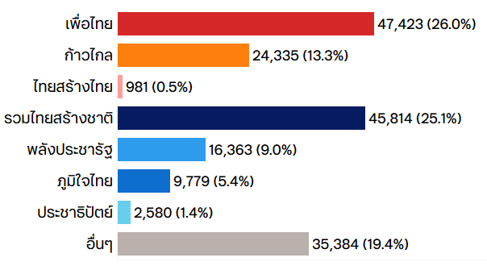
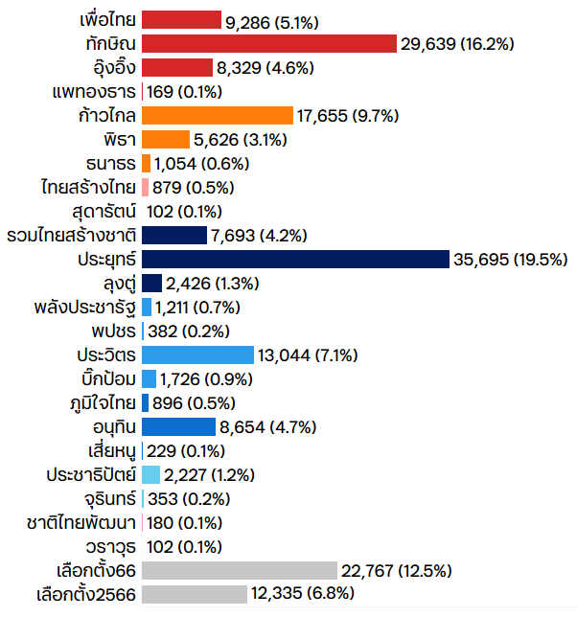
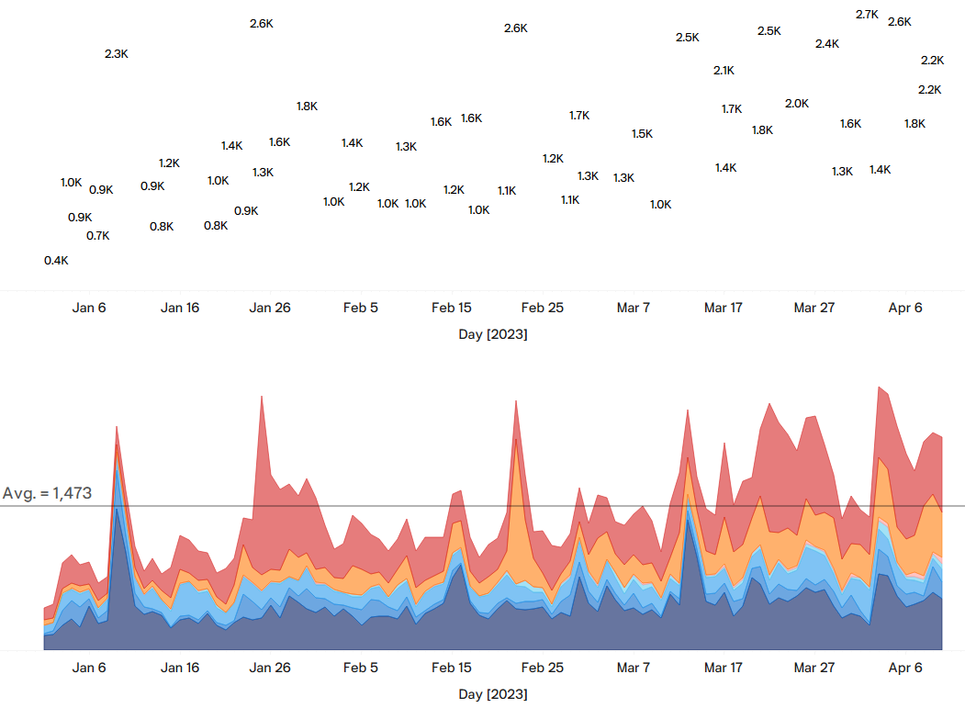
Using Snscrape To Scrape Tweet Data From Twitter
Data
Collection
Period: 1 Jan 2023 – 10 April 2023 (100 days) (Election Date: 14 May 2023)
Search 25 Keywords
6 Features
(Datetime, Username, Text, Tweet ID, No. of Like, No. of Retweet)
182,659 Tweets*
Label Sentiment
No. of Tweet by 7 Parties
No. of Tweet by 25 Keywords
1
3
Combine Keywords into 7 Party Names
7
Train/Test Split
2
4
5
6
Feature Extraction
No. of Tweet by Day ( 1 Jan 2023 – 11 April 2023 )
Model Selection
Framework
*Remove duplicate tweets of the same username and the same text
4

Slide 5
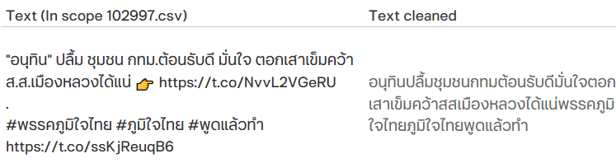
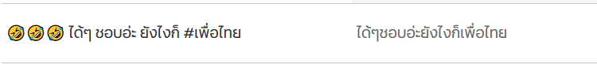
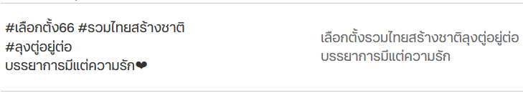
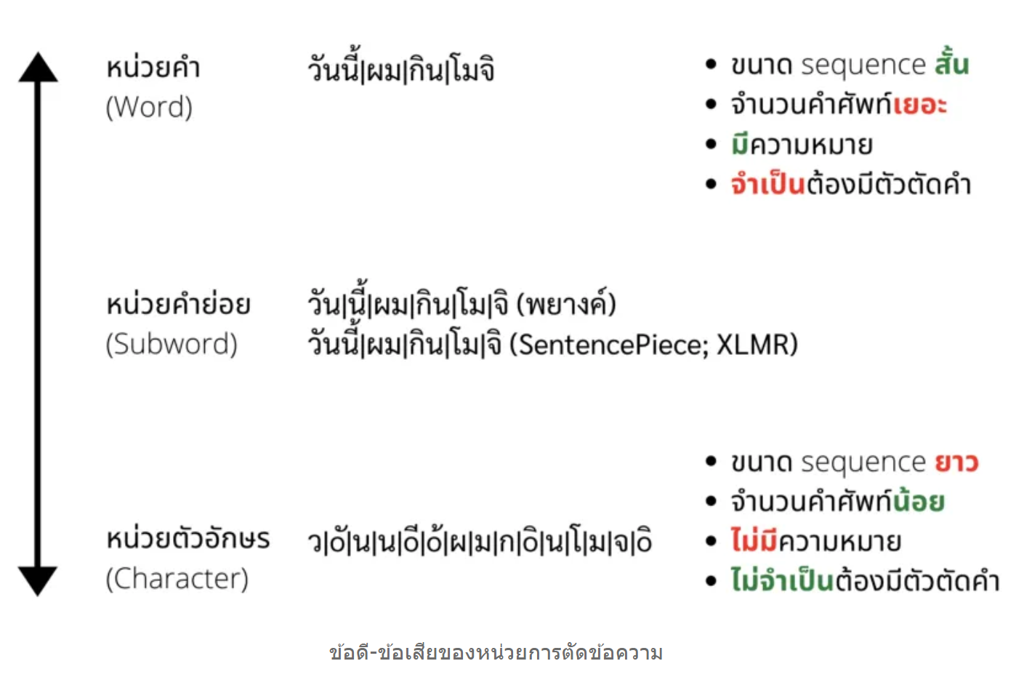

Cleansing Data
Example of Cleaned Texts
Data
Preprocessing
Remove Emoji
Remove non-alphabet
Remove URL
Remove Hashtag
Remove Stopword
Remove more than 3 repetitive characters such as ดีมากกก to ดีมาก
Word Tokenized
Types of Word Tokens
newmm : a dictionary-based Thai word tokenizer based on maximal matching from PyThaiNLP.
spm: a subword-level token from SentencePiece library.
sefr: a ML-based Thai word tokenizer based on Stacked Ensemble Filter and Refine (SEFR) [Limkonchotiwat et al., 2020] based on probabilities from CNN-based deepcut and SEFR tokenizer is loaded with engine="best".
5

Slide 6
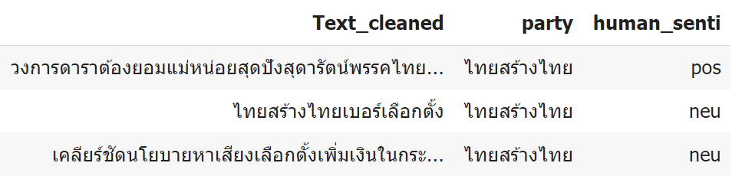


Assign Sentiment Value In A Random Test Set Manually To Evaluate Model Performance
Test set: 1,000 tweets are selected randomly,
with party proportions equivalent to the overall data.
Sentiment values are assigned by human annotators
Example Of Sentiment By Human
Label
Sentiment
Test Set
182,659
Tweets
Label the sentiment of each tweet manually
Selected randomly with party proportions equivalent to the overall data
1,000
Tweets
1,000 Tweets
With Sentiment
4-class text classification
Negative
Neutral
Positive
Question
% of Total
35%
49%
14%
3%
No. of Message
348
487
137
28
6

Slide 7

Wisesight sentiment corpus is used to train models and to measure model performance
Dataset For
Training Model
Split
Train : Test : Validate
(76:10:14)
Train/Test
Split
26,737 messages
Wisesight Sentiment
4-class text classification task based on social media posts and tweets.
Negative
Neutral
Positive
Question
No. of Message
6,823
14,561
4,778
575
% of Total
26%
54%
18%
2%
https://github.com/PyThaiNLP/wisesight-sentiment
7

Slide 8
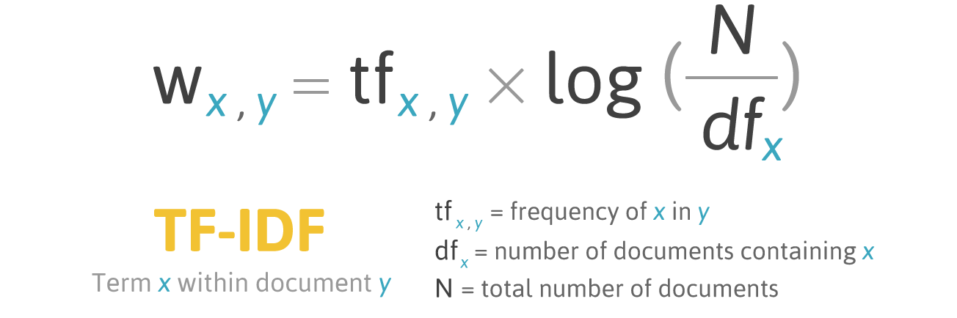
TF-IDF: Term Frequency-Inverse Document Frequency
It is a numerical representation of the importance of a term (word) in a collection of documents.
TF-IDF is commonly used in natural language processing and information retrieval to represent and rank the significance of words in a corpus.
Feature
Extraction
TF-IDF(t, d) = Term Frequency (TF) * Inverse Document Frequency (IDF)
Where:
Term Frequency (TF) is the number of times a term 't' appears in a specific document 'd'.
TF(t, d) = (Number of occurrences of term t in document d) / (Total number of terms in document d)
Inverse Document Frequency (IDF) is a measure of how unique or important a term is across the entire collection of documents. It helps to down-weight terms that appear frequently in many documents, as they tend to be less informative.
IDF(t) = log_e(Total number of documents / Number of documents containing term t)
8

Slide 9

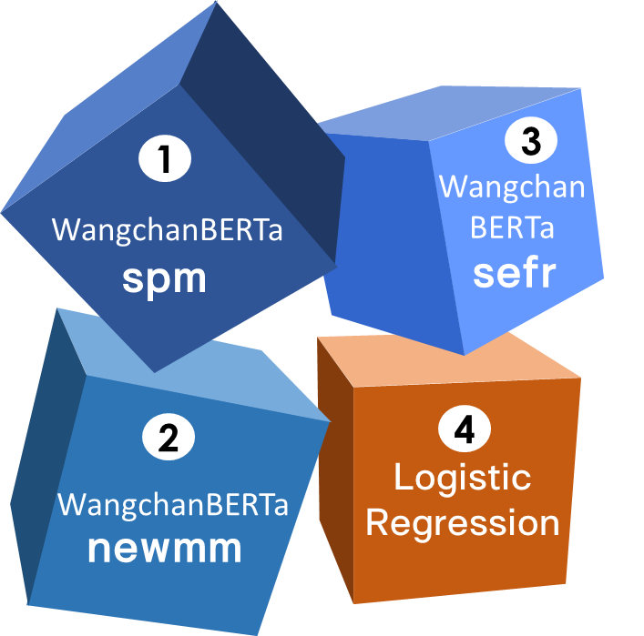
Evaluation and Compare Model Performance
wangchanberta-base-att-spm-uncased
wangchanberta-base-wiki-sefr
- Largest WangchanBERTa trained on 78.5GB of Assorted Thai Texts with subword tokenizer SentencePiece
3
1
- WangchanBERTa trained on Thai Wikipedia Dump with word-level tokenizer SEFR
Wangchan
BERTa
WangchanBERTa
spm
sefr
Model
Evaluation
wangchanberta-base-wiki-newmm
4
Logistic Regression
2
Logistic Regression
- Logistic Regression trained on Wisesight Sentiment corpus with with PyThaiNLP's word-level tokenizer
WangchanBERTa
- WangchanBERTa trained on Thai Wikipedia Dump with PyThaiNLP's word-level tokenizer newmm
newmm
9

Slide 10
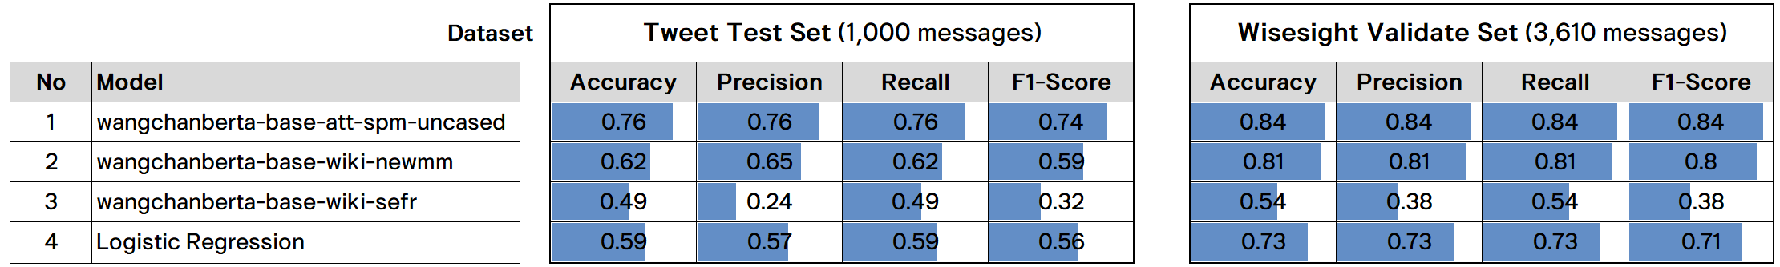
Optimal Model Choice: wangchanberta-base-att-spm-uncased Outperforms in Both Datasets
Model
Evaluation
ACCURACY
ACCURACY
wangchanberta-base-att-spm-uncased
0.84
wangchanberta-base-att-spm-uncased
0.81
0.76
wangchanberta-base-wiki-newmm
0.73
Logistic Regression
0.62
wangchanberta-base-wiki-newmm
0.59
Logistic Regression
wangchanberta-base-wiki-sefr
0.54
0.59
0.49
wangchanberta-base-wiki-sefr
10

Slide 11
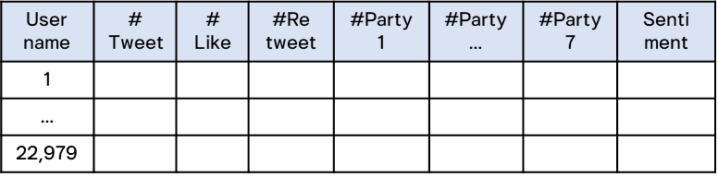
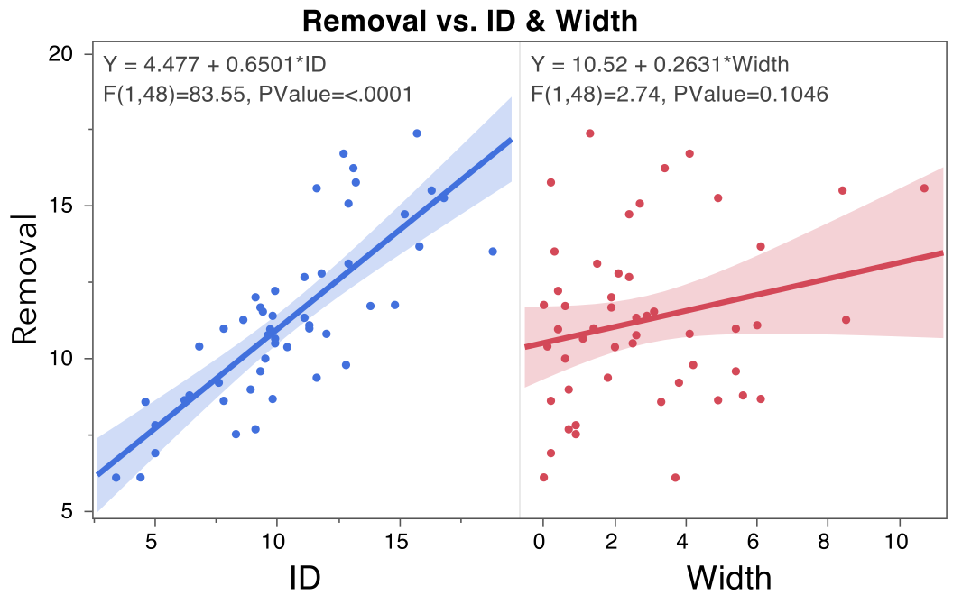

Framework
I ) User Level
II) Tweet Level
Create User Table
Analyze and contrast
the proportion of votes for the 7 parties in the actual party-list vote results
with the data extracted from Twitter.
Incorporate Twitter data into the model for sentiment classification.
wangchanberta-base-att-spm-uncased
Party Vote Scoring by User
Actual Party-list
Vote Results
VS
Data From
Twitter
Lebel
Pos
Neu
Neg
Weight
3
1
-2
ก้าวไกล
Criteria For Selecting Tweets In Analysis Scope
Group
No. of Tweet by Party and Sentiment
Score
?
LOVER
VS
182,659 Tweets
Party A
เพื่อไทย
ภูมิใจไทย
Remove
Duplicate Tweets
10
Tweets
ประชาธิปัตย์
รวมไทยสร้างชาติ
พลังประชารัฐ
ไทยสร้างไทย
Related
7 Parties
ATTACKER
Party E
One-party Mention
Analyze Tweets in 2 Levels
Multiple Linear Regression
19
Tweets
To find the best-fitting linear equation that represents the relationship between the Vote Ranking and these independent variables.
Exclude Question Tweets
BOTH
Love
Attack
Party B
Party E
No. of Tweet
No. of Retweet
Users who
tweeted$≤$ 300
24
Tweets
No. of Like
Sentiment
Remove unrelated tweets
102,997
Tweets
Party Voting Patterns among Twitter Users Analysis

Slide 12
Framework
I ) User Level
II) Tweet Level
Create User Table
Analyze and contrast
the proportion of votes for the 7 parties in the actual party-list vote results
with the data extracted from Twitter.
Incorporate Twitter data into the model for sentiment classification.
wangchanberta-base-att-spm-uncased
Party Vote Scoring by User
Actual Party-list
Vote Results
VS
Data From
Twitter
Lebel
Pos
Neu
Neg
Weight
3
1
-2
ก้าวไกล
Criteria For Selecting Tweets In Analysis Scope
Group
No. of Tweet by Party and Sentiment
Score
?
LOVER
VS
182,659 Tweets
Party A
เพื่อไทย
ภูมิใจไทย
Remove
Duplicate Tweets
10
Tweets
ประชาธิปัตย์
รวมไทยสร้างชาติ
พลังประชารัฐ
ไทยสร้างไทย
Related
7 Parties
ATTACKER
Party E
One-party Mention
Analyze Tweets in 2 Levels
Multiple Linear Regression
19
Tweets
To find the best-fitting linear equation that represents the relationship between the Vote Ranking and these independent variables.
Exclude Question Tweets
BOTH
Love
Attack
Party B
Party E
No. of Tweet
No. of Retweet
Users who
tweeted$≤$ 300
24
Tweets
No. of Like
Sentiment
Remove unrelated tweets
102,997
Tweets
Party Voting Patterns among Twitter Users Analysis

Slide 13









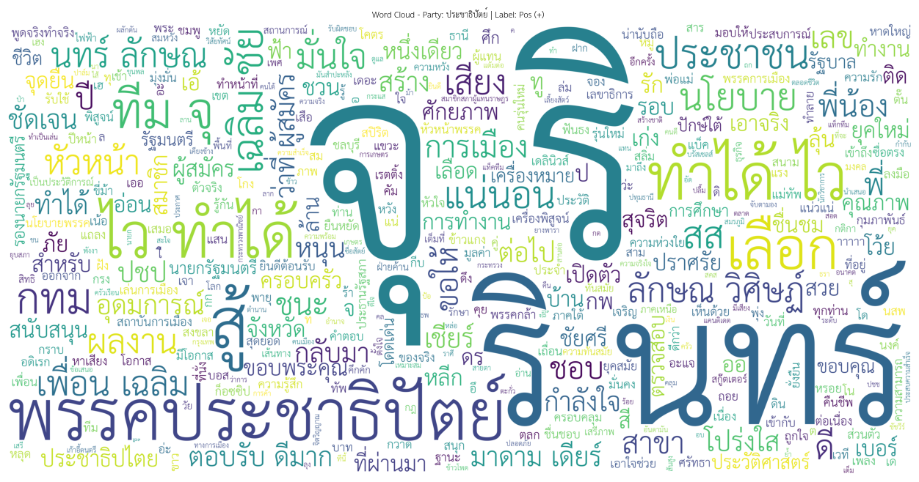




Word cloud
Visualization
By Party
By Sentiment
เพื่อไทย
ก้าวไกล
ไทยสร้างไทย
POS
NEG
รวมไทยสร้างชาติ
ประชารัฐ
ภูมิใจไทย
ประชาธิปัตย์
POS
NEG
13

Slide 14
Framework
I ) User Level
II) Tweet Level
Create User Table
Analyze and contrast
the proportion of votes for the 7 parties in the actual party-list vote results
with the data extracted from Twitter.
Incorporate Twitter data into the model for sentiment classification.
wangchanberta-base-att-spm-uncased
Party Vote Scoring by User
Actual Party-list
Vote Results
VS
Data From
Twitter
Lebel
Pos
Neu
Neg
Weight
3
1
-2
ก้าวไกล
Criteria For Selecting Tweets In Analysis Scope
Group
No. of Tweet by Party and Sentiment
Score
?
LOVER
VS
182,659 Tweets
Party A
เพื่อไทย
ภูมิใจไทย
Remove
Duplicate Tweets
10
Tweets
ประชาธิปัตย์
รวมไทยสร้างชาติ
พลังประชารัฐ
ไทยสร้างไทย
Related
7 Parties
ATTACKER
Party E
One-party Mention
Analyze Tweets in 2 Levels
Multiple Linear Regression
19
Tweets
To find the best-fitting linear equation that represents the relationship between the Vote Ranking and these independent variables.
Exclude Question Tweets
BOTH
Love
Attack
Party B
Party E
No. of Tweet
No. of Retweet
Users who
tweeted$≤$ 300
24
Tweets
No. of Like
Sentiment
Remove unrelated tweets
102,997
Tweets
Party Voting Patterns among Twitter Users Analysis

Slide 15
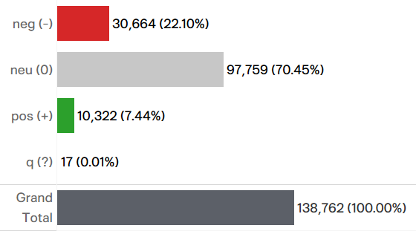
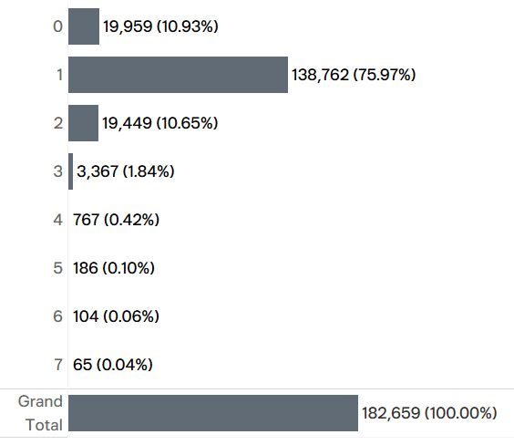
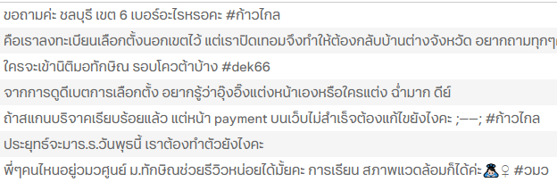
Criteria For Selecting Tweets In Analysis Scope
Select Only Tweet Mentioning Only One Party In Order To Be Able To Convey Which Party The Opinion Refers To And Exclude Question Tweets
Select only tweet mentioning only one party in order to be able to convey which party the opinion refers to
Exclude Question Tweets
Tweet Distribution By Sentiment
Tweet Distribution By No. of Mentioned Party
138,745
Tweets
Sentiment
138,762
Tweets
No. of Mentioned Party
Example of Question Tweets
*
*Already Removed duplicate tweets of the same username and the same text
15

Slide 16
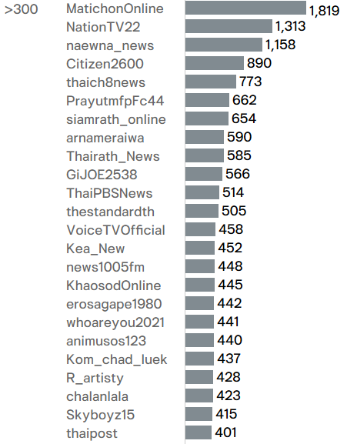
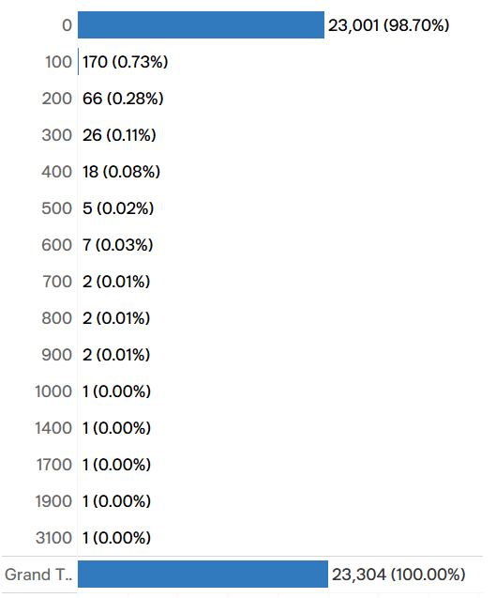
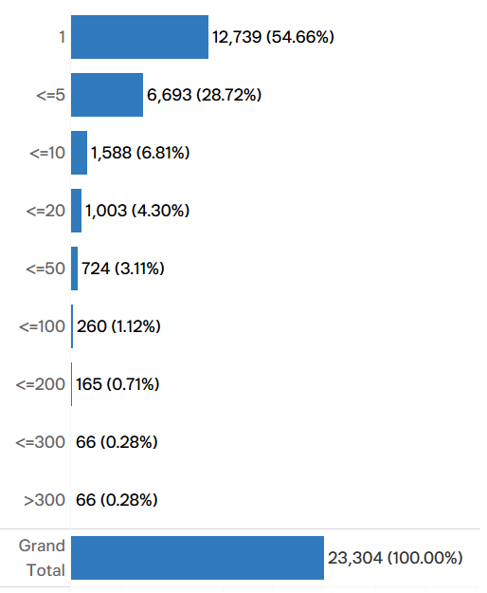
Criteria For Selecting Tweets In Analysis Scope
Focus On Tweets Posted By Users Who Tweeted Fewer Than 300 Tweets
99.7% Of All Users Posted Less Than 300 Tweets
The Majority Of Users With >300 Tweets Are News Organizations
Username Distribution By No. of Tweet
Example of User with Tweets > 300
Username
No. of Tweets
Bin 100
Zoom in Bin <=300
99.7%
Exclude Users With >300 Tweets
Np. Of Tweet Per Username
Framework
16

Slide 17

Criteria For Selecting Tweets In Analysis Scope
103K Tweets Will Be Used To Analyze
Party Voting Patterns Among Twitter Users
Remove
Duplicate Tweets
No. of Tweet
182,659
Related
7 Parties
Tweets with only one-party mention
Exclude Question Tweets
100%
147,275
Users who tweeted
<= 300
81%
138,762
138,745
Remove unrelated tweets*
76%
76%
117,874
65%
102,997
56%
No. of User
27.9K
23.3K
23.3K
23.3K
23.2K
22.9K
*tweets contained these words “ช้อปเลย|โปรดีๆ|ส่วนลด|งานออนไลน์|พร้อมส่ง|ป้ายยา|ช้อป|รับหิ้ว|รวมส่ง|โค้ดลด|แถมฟรี|ลดราคาเหลือ|สนใจทัก|ไม่มีขั้นต่ำ|ส่งฟรี|พร้อมโอน|ปล่อยกู้รายเดือน|ราคาชิ้นละ|ส่งต่อเสื้อผ้า|เสื้อเปิดไหล่|ดีลเดือด|ราคาถูก|ดูดวง|พร้อมส่ง|Spotify|ถอนได้ไม่อั้น|ซื้อตู้เย็น|เสื้อกล้าม|มีงานมาแนะนำ|เกมมือถือ|เสื้อสงกราน|แอนจักรพงษ์|เที่ยวงาน|สอบถามจองคิว|ยำขนมจีน|ครีมบำรุงหน้า|มอทักษิณ,|Google Search Trend|นศ.ทักษิณ|รับสมัครงาน”
17

Slide 18
Framework
I ) User Level
II) Tweet Level
Create User Table
Analyze and contrast
the proportion of votes for the 7 parties in the actual party-list vote results
with the data extracted from Twitter.
Incorporate Twitter data into the model for sentiment classification.
wangchanberta-base-att-spm-uncased
Party Vote Scoring by User
Actual Party-list
Vote Results
VS
Data From
Twitter
Lebel
Pos
Neu
Neg
Weight
3
1
-2
ก้าวไกล
Criteria For Selecting Tweets In Analysis Scope
Group
No. of Tweet by Party and Sentiment
Score
?
LOVER
VS
182,659 Tweets
Party A
เพื่อไทย
ภูมิใจไทย
Remove
Duplicate Tweets
10
Tweets
ประชาธิปัตย์
รวมไทยสร้างชาติ
พลังประชารัฐ
ไทยสร้างไทย
Related
7 Parties
ATTACKER
Party E
One-party Mention
Analyze Tweets in 2 Levels
Multiple Linear Regression
19
Tweets
To find the best-fitting linear equation that represents the relationship between the Vote Ranking and these independent variables.
Exclude Question Tweets
BOTH
Love
Attack
Party B
Party E
No. of Tweet
No. of Retweet
Users who
tweeted$≤$ 300
24
Tweets
No. of Like
Sentiment
Remove unrelated tweets
102,997
Tweets
Party Voting Patterns among Twitter Users Analysis

Slide 19

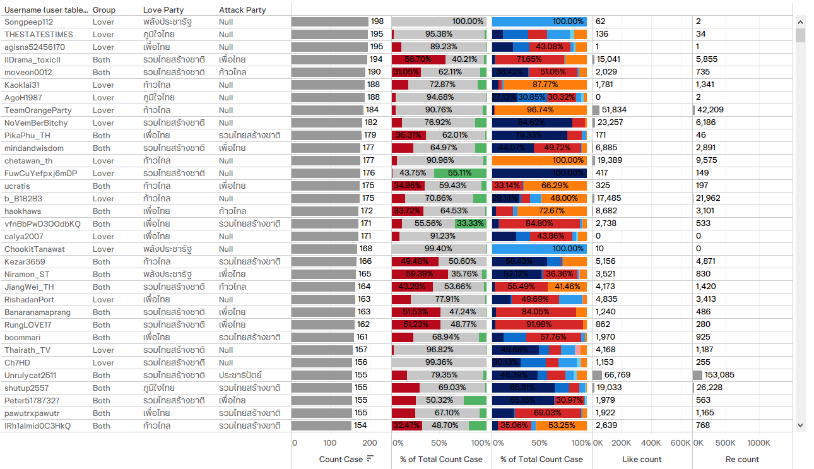
Gather Data From Individual Twitter Users
And Calculate Their Loved or Attacked
Towards Political Parties, Or Both.
102,997
Tweets
22,979
Users
ก้าวไกล
เพื่อไทย
ภูมิใจไทย
รวมไทยสร้างชาติ
ประชาธิปัตย์
พลังประชารัฐ
ไทยสร้างไทย
Create User Table
Party Vote Scoring by User
Pos
Neu
Neg
Group
#Tweet
%Sentiment
%Party
#Like
#Retweet
LOVE Party
ATTACK Party
LOVER
ATTACKER
BOTH
19

Slide 20

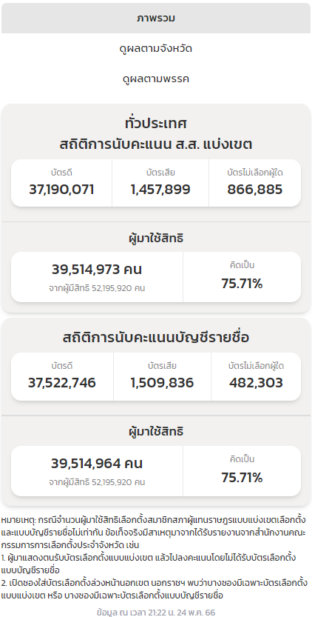
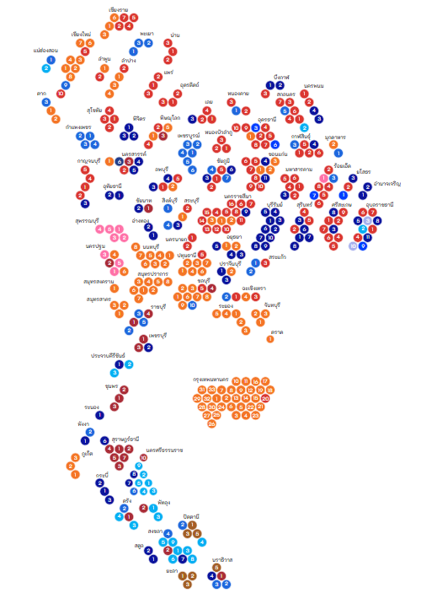
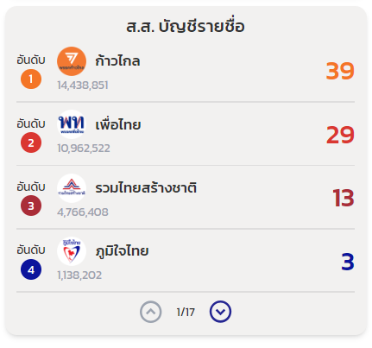
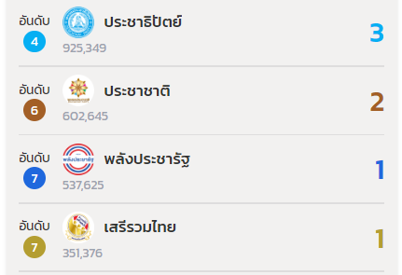
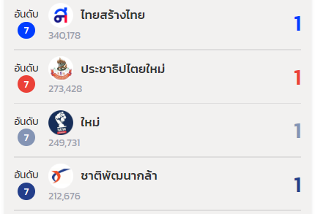
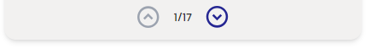
รายงานผลการเลือกตั้ง ส.ส. ปี พ.ศ.2566 อย่างเป็นทางการ
โดยสนใจเฉพาะผลคะแนนบัญชีรายชื่อเพื่อใช้ในการเปรียบเทียบกับผลการโหวตของผู้ใช้ Twitter
ผู้มีสิทธิเลือกตั้ง
ผู้มาใช้สิทธิ
บัตรดี +
บัตรไม่เลือกผู้ใด
คะแนนเสียง
7 พรรค
คะแนนบัญชี
รายชื่อ
39.51
ล้านคน
38.01
ล้านคน
33.11
ล้านคน
52.19
ล้านคน
75%
73%
63%
ก้าวไกล
1
ก้าวไกล
38.0%
43.6%
เพื่อไทย
28.8%
2
เพื่อไทย
33.1%
รวมไทยสร้างชาติ
12.5%
ภูมิใจไทย
3.0%
2.4%
ประชาธิปัตย์
3
รวมไทยสร้างชาติ
พลังประชารัฐ
1.4%
0.9%
ไทยสร้างไทย
14.4%
อื่นๆ
11.6%
4
ภูมิใจไทย
3.4%
ไม่เลือกผู้ใด
6
พลังประชารัฐ
1.6%
2.8%
ประชาธิปัตย์
5
1.3%
1.0%
ไทยสร้างไทย
7
https://official.ectreport.com/overview
20

Slide 21
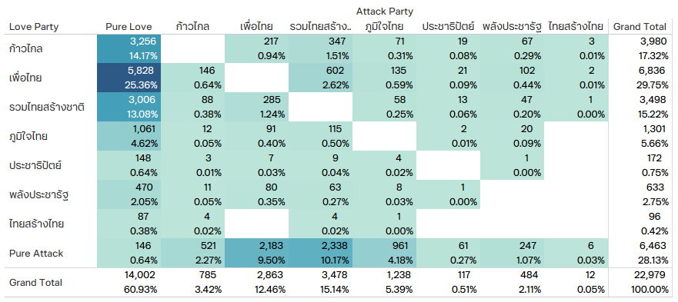
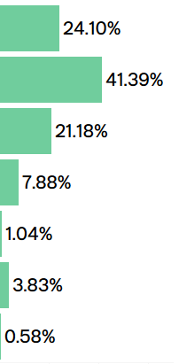
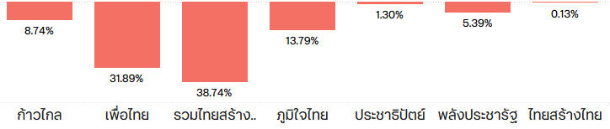
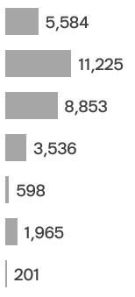
Party Voting Patterns among Twitter Users Analysis
22,979
Users
No. of User
by Group
Attacked Party
คะแนนเสียง
7 พรรค
LOVER
ก้าวไกล
33.11
ล้านคน
เพื่อไทย
รวมไทยสร้างชาติ
63%
60%
User Distribution By Loved Party
ภูมิใจไทย
13.9K
Loved Party
ประชาธิปัตย์
พลังประชารัฐ
ไทยสร้างไทย
1
ก้าวไกล
43.6%
ATTACKER
28%
6.5K
User Distribution By Attacked Party
2
เพื่อไทย
No. of User
User Distribution By Group
33.1%
Pure Attack
Attack
Neutral
Love
Pure Love
BOTH
ก้าวไกล
12%
เพื่อไทย
รวมไทยสร้างชาติ
3
รวมไทยสร้างชาติ
2.7K
ภูมิใจไทย
14.4%
ประชาธิปัตย์
4
ภูมิใจไทย
3.4%
พลังประชารัฐ
6
พลังประชารัฐ
1.6%
2.8%
ประชาธิปัตย์
5
ไทยสร้างไทย
1.0%
ไทยสร้างไทย
7
21

Slide 22
Framework
I ) User Level
II) Tweet Level
Create User Table
Analyze and contrast
the proportion of votes for the 7 parties in the actual party-list vote results
with the data extracted from Twitter.
Incorporate Twitter data into the model for sentiment classification.
wangchanberta-base-att-spm-uncased
Party Vote Scoring by User
Actual Party-list
Vote Results
VS
Data From
Twitter
Lebel
Pos
Neu
Neg
Weight
3
1
-2
ก้าวไกล
Criteria For Selecting Tweets In Analysis Scope
Group
No. of Tweet by Party and Sentiment
Score
?
LOVER
VS
182,659 Tweets
Party A
เพื่อไทย
ภูมิใจไทย
Remove
Duplicate Tweets
10
Tweets
ประชาธิปัตย์
รวมไทยสร้างชาติ
พลังประชารัฐ
ไทยสร้างไทย
Related
7 Parties
ATTACKER
Party E
One-party Mention
Analyze Tweets in 2 Levels
Multiple Linear Regression
19
Tweets
To find the best-fitting linear equation that represents the relationship between the Vote Ranking and these independent variables.
Exclude Question Tweets
BOTH
Love
Attack
Party B
Party E
No. of Tweet
No. of Retweet
Users who
tweeted$≤$ 300
24
Tweets
No. of Like
Sentiment
Remove unrelated tweets
102,997
Tweets
Party Voting Patterns among Twitter Users Analysis

Slide 23
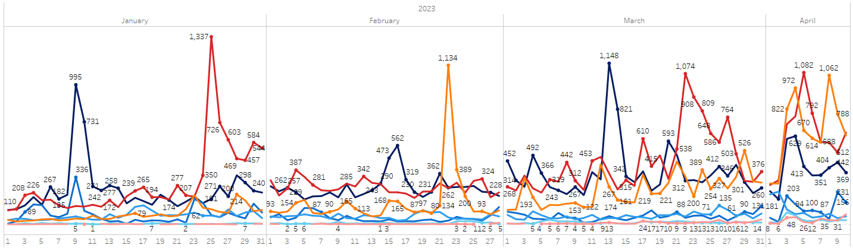
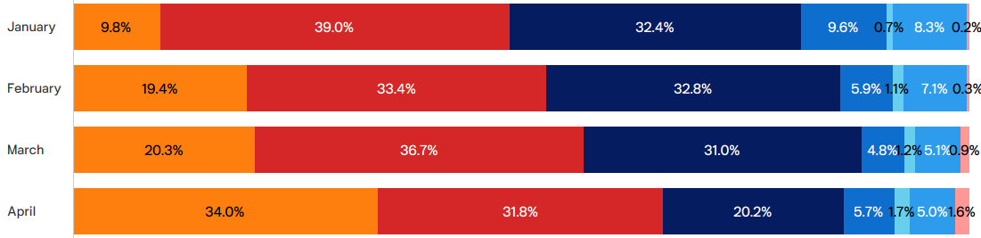

Compare The Proportion Of Votes For The 7 Parties
The three political parties that are most trending on Twitter are เพื่อไทย, รวมไทยสร้างชาติ และก้าวไกล
No. of Tweets by Time
ก้าวไกล
พลังประชารัฐ
รวมไทยสร้างชาติ
ประชาธิปัตย์
ภูมิใจไทย
เพื่อไทย
ไทยสร้างไทย
No. of tweets
Proportion of Tweets by Party
Total Period (100 Days)
102,997
As election day approaches, the proportion of the number of Tweets is expected to align more closely with the actual election results.
Monthly
23,298
22,384
37,542
19,773
คะแนนบัญชีรายชื่อ 7 พรรค
33.11
ล้านคน
43.6%
33.1%
14.4%
3.4%
1.6%
2.8%
1.0%
23

Slide 24
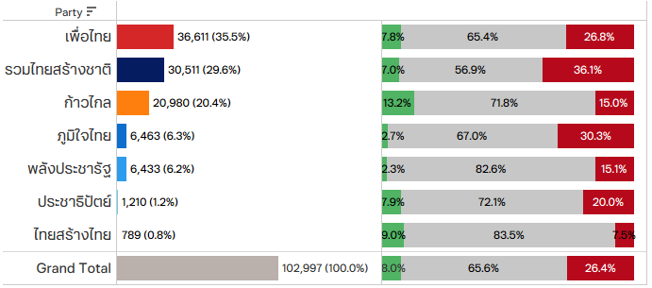
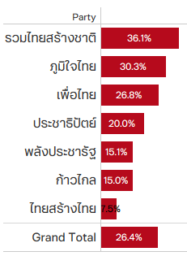
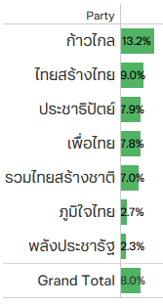
The Number Of Mentions In Tweets Doesn't Guarantee Corresponding Votes; Sentiment Analysis Is Also Essential
No. of Tweet
Proportion of Sentiment
Pos
Neu
Neg
Neg
Pos
1
1
1
2
2
2
3
3
3
Although a significant number of mentions in Tweets does not guarantee a corresponding number of votes, it is essential to consider the sentiment associated with the mentions.
รวมไทยสร้างชาติ , despite ranking second in the number of tweets, has the highest proportion of negative tweets at 36%, followed by ภูมิใจไทย with 30% negative tweets.
Despite being the third most tweeted party, ก้าวไกล has the highest percentage of positive comments at 13%, while ไทยสร้างไทย follows with 9% positive comments.
เพื่อไทย receives the highest number of mentions among users in consideration of the number of Tweets, followed by รวมไทยสร้างชาติ and ก้าวไกล ,respectively
รวมไทยสร้างชาติ
เพื่อไทย
ก้าวไกล
รวมไทยสร้างชาติ
ก้าวไกล
ไทยสร้างไทย
ภูมิใจไทย
24

Slide 25
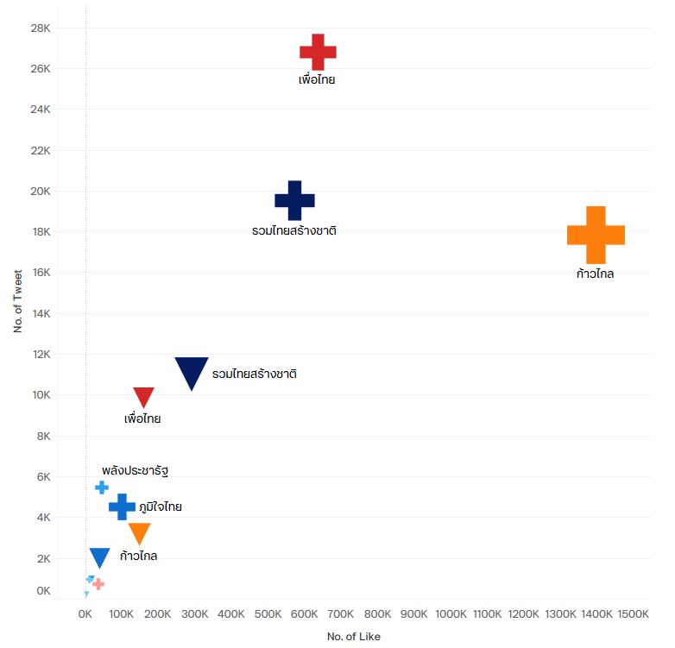
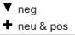
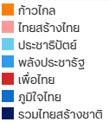
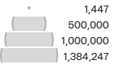
In Addition To The Number Of Tweets And Sentiment,
Other Vital Factors To Consider Are The Number Of Likes And Retweets.
Scatter Plot by Party
Shape represents Sentiment
Highest Positive #Tweet
Highest Positive
#LIKE & #Retweet
Color represents Party
Highest Negative
#Tweet #Like #Retweet
Size represents No. of Retweet
25

Slide 26
Compare The Proportion of….
Actual Party-list Vote Results vs No. of Tweets vs No. of Likes vs No. of Retweets
The proportion of actual party-list vote results closely aligns with the proportion of positive and neutral likes.
Actual
Party-list
Vote Results
All Sentiment
Positive + Neutral
Negative
Actual Number
% of Total
26

Slide 27
Utilize Multiple Linear Regression
To Establish The Relationship Between
Vote Ranking And The Independent Variables
Independent Variables
No. of Tweet
No. of Retweet
No. of Like
Sentiment
Multiple Linear Regression
The equation takes the form:
Y = β₀ + β₁X₁ + β₂X₂ + ... + βₚXₚ + ɛ
MLR is a statistical technique used to model the relationship between a dependent variable and two or more independent variables.
In multiple linear regression, the goal is to find the best-fitting linear equation that represents the relationship between the dependent variable and the independent variables. The aim of multiple linear regression is to estimate the regression coefficients that minimize the sum of squared differences between the predicted values and the actual values of the dependent variable.
This estimation is typically done using a method called ordinary least squares (OLS).
Where:
Y represents the dependent variable or the variable being predicted.
X₁, X₂, ..., Xₚ represent the independent variables or predictors.
β₀, β₁, β₂, ..., βₚ are the regression coefficients or the parameters to be estimated. β₀ is the intercept term, and β₁, β₂, ..., βₚ are the coefficients corresponding to the independent variables.
ɛ represents the error term or residual, which accounts for the variability not explained by the model.
27

Slide 28
Multiple Linear Regressions With The Smallest Mean Squared Error (MSE)
Are Equations With 3 Independent Variables (#Positive Retweet, #Negative Retweet, and #Neutral Retweet)
Independent Variables
Dependent
Variable
All Sentiment
Pos
Neu
Neg
Pos + Neutral
Party | Score Rank | #Tweet | #Like | #Retweet | #Tweet_ Pos | #Like_ Pos | #Retweet_ Pos | #Tweet_ Neu | #Like_ Neu | #Retweet_ Neu | #Tweet_ Neg | #Like_ Neg | #Retweet_ Neg | #Tweet_ Pos+Neu | #Like_ Pos+Neu | #Retweet_ Pos+Neu
ก้าวไกล | 1 | 20,980 | 1,544,421 | 1,609,575 | 2,767 | 255,837 | 242,641 | 15,060 | 1,139,891 | 1,141,606 | 3,153 | 148,693 | 225,328 | 17,827 | 1,395,728 | 1,384,247
เพื่อไทย | 2 | 36,611 | 797,018 | 755,372 | 2,845 | 82,358 | 49,519 | 23,942 | 554,321 | 503,941 | 9,824 | 160,339 | 201,912 | 26,787 | 636,679 | 553,460
รวมไทยสร้างชาติ | 3 | 30,511 | 865,664 | 1,170,978 | 2,150 | 95,019 | 109,344 | 17,351 | 478,687 | 549,930 | 11,010 | 291,958 | 511,704 | 19,501 | 573,706 | 659,274
ภูมิใจไทย | 4 | 6,463 | 140,938 | 488,411 | 177 | 13,790 | 44,180 | 4,329 | 86,436 | 249,370 | 1,957 | 40,712 | 194,861 | 4,506 | 100,226 | 293,550
ประชาธิปัตย์ | 5 | 1,210 | 14,309 | 34,299 | 95 | 550 | 81 | 873 | 9,780 | 21,094 | 242 | 3,979 | 13,124 | 968 | 10,330 | 21,175
พลังประชารัฐ | 6 | 6,433 | 62,218 | 93,827 | 148 | 244 | 187 | 5,313 | 45,554 | 73,989 | 972 | 16,420 | 19,651 | 5,461 | 45,798 | 74,176
ไทยสร้างไทย | 7 | 789 | 37,659 | 58,568 | 71 | 13,462 | 24,157 | 659 | 23,025 | 32,964 | 59 | 1,172 | 1,447 | 730 | 36,487 | 57,121
 | Total | 102,997 | 3,462,227 | 4,211,030 | 8,253 | 461,260 | 470,109 | 67,527 | 2,337,694 | 2,572,894 | 27,217 | 663,273 | 1,168,027 | 75,780 | 2,798,954 | 3,043,003
ก้าวไกล | 1 | 0.2037 | 0.4461 | 0.3822 | 0.3353 | 0.5546 | 0.5161 | 0.2230 | 0.4876 | 0.4437 | 0.1158 | 0.2242 | 0.1929 | 0.2352 | 0.4987 | 0.4549
เพื่อไทย | 2 | 0.3555 | 0.2302 | 0.1794 | 0.3447 | 0.1786 | 0.1053 | 0.3546 | 0.2371 | 0.1959 | 0.3610 | 0.2417 | 0.1729 | 0.3535 | 0.2275 | 0.1819
รวมไทยสร้างชาติ | 3 | 0.2962 | 0.2500 | 0.2781 | 0.2605 | 0.2060 | 0.2326 | 0.2569 | 0.2048 | 0.2137 | 0.4045 | 0.4402 | 0.4381 | 0.2573 | 0.2050 | 0.2167
ภูมิใจไทย | 4 | 0.0627 | 0.0407 | 0.1160 | 0.0214 | 0.0299 | 0.0940 | 0.0641 | 0.0370 | 0.0969 | 0.0719 | 0.0614 | 0.1668 | 0.0595 | 0.0358 | 0.0965
ประชาธิปัตย์ | 5 | 0.0117 | 0.0041 | 0.0081 | 0.0115 | 0.0012 | 0.0002 | 0.0129 | 0.0042 | 0.0082 | 0.0089 | 0.0060 | 0.0112 | 0.0128 | 0.0037 | 0.0070
พลังประชารัฐ | 6 | 0.0625 | 0.0180 | 0.0223 | 0.0179 | 0.0005 | 0.0004 | 0.0787 | 0.0195 | 0.0288 | 0.0357 | 0.0248 | 0.0168 | 0.0721 | 0.0164 | 0.0244
ไทยสร้างไทย | 7 | 0.0077 | 0.0109 | 0.0139 | 0.0086 | 0.0292 | 0.0514 | 0.0098 | 0.0098 | 0.0128 | 0.0022 | 0.0018 | 0.0012 | 0.0096 | 0.0130 | 0.0188
 | Total | 1.0000 | 1.0000 | 1.0000 | 1.0000 | 1.0000 | 1.0000 | 1.0000 | 1.0000 | 1.0000 | 1.0000 | 1.0000 | 1.0000 | 1.0000 | 1.0000 | 1.0000
Actual Number
% of Total
Mean Squared Error (MSE)
Experiment with creating multiple linear regressions by importing different independent variables to estimate the regression coefficients that minimize the Mean Squared Error (MSE).
#Independent Variable | 1 |  |  |  |  | 2 | 3
Sentiment | - | Pos | Neu | Neg | Pos+Neu | Neg, Pos+Neu | Pos, Neu, Neg
#Tweet | 1.4834999 | 0.7800148 | 1.3033971 | 2.392686 | 1.2060886 | 0.991226016 | 0.733640916
#Like | 0.7898197 | 1.2905683 | 0.8623104 | 1.9466772 | 0.9284993 | 0.768494314 | 0.500350176
#Retweet | 0.78955 | 1.5932825 | 0.7701433 | 2.2920527 | 0.8908814 | 0.779889207 | 0.256295584
MSE
28

Slide 29

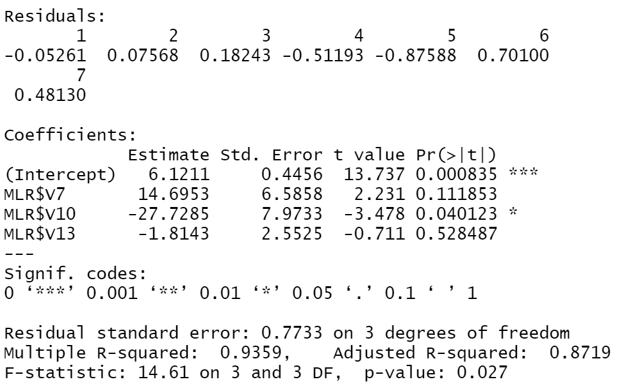
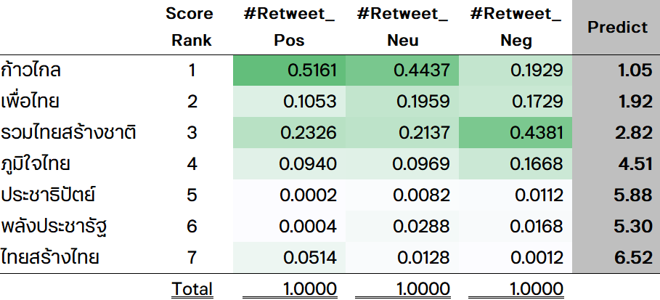
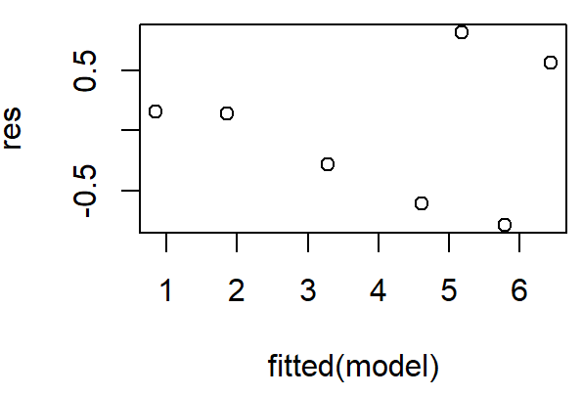
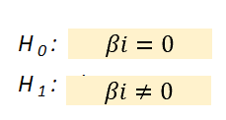
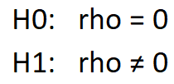
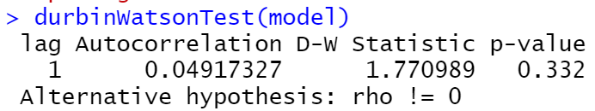

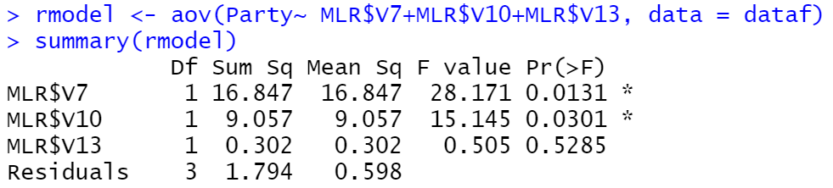
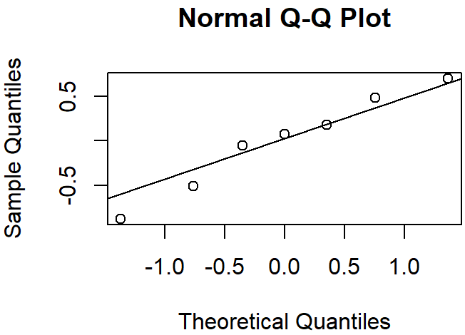
#Negative Retweet Has No Effect To Party Vote Score Ranking
Multiple Linear Regression
Objective:
Are number of retweets in Twitter in each sentiment predictive of party vote score ranking?
MSE: 0.2563
Data collection:
Estimation of Coefficients (OLS):
Y = β₀ + β₁X₁ + β₂X₂ + β₃X₃ + ɛ
Score Rank
= 6.1211
+14.6953 (#Retweet_Pos)
-27.7285 (#Retweet_Neu)
-1.8143 (#Retweet_Neg)
#RT_Pos
#RT_Neu
#RT_Neg
∴ Random errors are homogeneity of variance
No outlier
Test Hypothesis:
Alpha
> Alpha 0.05
Do not reject Ho
#RT_Pos
#RT_Neu
#RT_Neg
<0.05 Reject Ho
At the 0.05 level of significance, Random errors are independent.
<0.05 Reject Ho
>0.05 Do not reject Ho
Random errors follow line
∴ Random errors are Normal Distribution
At the 0.05 level of significance, RT_Pos and RT_Neu has effect to party vote score ranking
At the 0.05 level of significance, RT_Neg has no effect to party vote score ranking
29

Slide 30
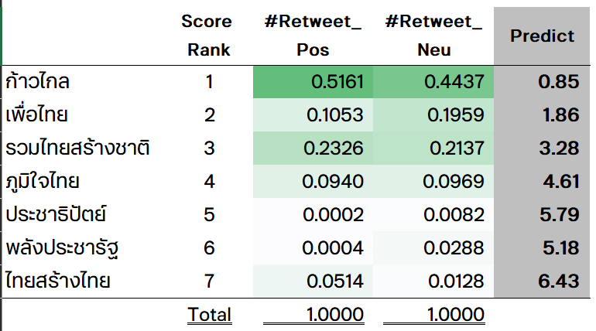
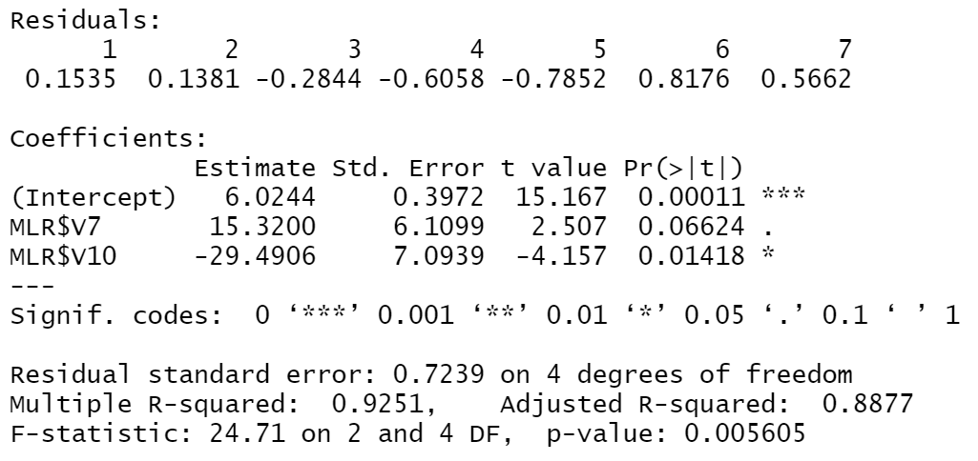




MLR With 2 Independent Variables Is Consistent With All Assumptions.
(#Positive Retweet & #Neutral Retweet)
Multiple Linear Regression
Objective:
Are number of retweets in Twitter in each sentiment predictive of party vote score ranking?
MSE: 0.2994
Data collection:
Estimation of Coefficients (OLS):
Y = β₀ + β₁X₁ + β₂X₂ + ɛ
Score Rank
= 6.0244
+15.32 (#Retweet_Pos)
-29.4906 (#Retweet_Neu)
#RT_Pos .
#RT_Neu .
∴ Random errors are homogeneity of variance
No outlier
Test Hypothesis:
> Alpha 0.05
Do not reject Ho
Alpha
At the 0.05 level of significance, Random errors are independent.
#RT_Pos
#RT_Neu
<0.05 Reject Ho
<0.05 Reject Ho
Random errors follow line
∴ Random errors are Normal Distribution
At the 0.05 level of significance, RT_Pos and RT_Neu has effect to party vote score ranking
30

Slide 31

Summary
Party Voting Patterns among Twitter Users Analysis
102,997
Tweets
22,979
Users
I ) User Level
II) Tweet Level
22,979 Users
Mere tweet count is insufficient for predicting the selection outcome; considering the number of likes and retweets, along with sentiment analysis, enhances prediction accuracy.
wangchanberta-base-att-spm-uncased
LOVER
ATTACKER
BOTH
60%
28%
12%
Party with Max Count
Sentiment | All | Pos | Neu | Neg
#Tweet
#Like
#Retweet
0.76
เพื่อไทย
เพื่อไทย
เพื่อไทย
รทสช
ก้าวไกล
ก้าวไกล
ก้าวไกล
รทสช
2
ก้าวไกล
ก้าวไกล
ก้าวไกล
ก้าวไกล
รทสช
Analyze Tweets in 2 Levels
เพื่อไทย
2
Multiple Linear Regression
Accuracy on Tweet Test Set
1
เพื่อไทย
The relationship between a Twitter user's number of positive and neutral retweets and a political party's vote ranking can be described by a linear correlation, as expressed in this equation.
รทสช
1
is applied to classify sentiment
No. of Tweet
No. of Retweet
Neu
3
รทสช
No. of Like
Sentiment
Pos
ภูมิใจไทย
3
Score Rank = 6.02 +15.32 (#Retweet_Pos)
-29.49 (#Retweet_Neu)
31

Slide 32
Limitations
No tweet information is available around the time of the election. (11 April 2023 – 14 May 2023)
Future
Work
In this analysis, emojis were excluded from the text. However, it is important to acknowledge that emojis can convey emotions and should be taken into consideration for recognizing sentiments.
This framework should be backtested with other data sets.
32

Slide 33
Appendix
Code_Colab
https://colab.research.google.com/drive/1caasFG6ha3rR9Wu3g6tsjU-ZhT2TmSMw?usp=sharing

Slide 34
Literature Review
Year | Papers | Algorithm | Scenario | Resource | Metric | Performane
2021 | PREDICTING THE 2020 US PRESIDENTIAL ELECTION WITH TWITTER | VADER sentiment and structural data with aggregate polling, a time series analysis | 2020 US Presidential election | Twitter A) 1.7 million tweet data set from Kaggle user B) scraping historical tweets from multiple prominent accounts. ( 57 accounts,3200 tweets) from presidential candidates, news organizations, political pundits, and politicians | MAE | This method performed worse than its baseline of polling predictions
2016 | Prediction of Indian Election Using Sentiment Analysis on Hindi Twitter | Dictionary Based, Naive Bayes and SVM | 2016 India general state election | Twitter - 42,235 tweets (1 month during the campaigning period) | Accuracy | - SVM predicted a 78.4% chance that the BJP would win - As it turned out, BJP won 60 out of 126 constituencies in the 2016 general election
2022 | Sentiment Analysis on Twitter for the Major German Parties during the 2021 German Federal Election | transformer-based models (BERT) | 2021 German federal election | Twitter 58,000 tweets from 7 parties | Accuracy, macro F1, weighted f1 score | - BERT model achieved an accuracy of 93.3% and macro f1 score of 93.4%.
2022 | Understanding Social Media Behavior in Philippines Presidential Election using Natural Language Processing | SVM (to classify sentiment) - LDA (to discover hidden topics from the given corpus) - K-means (to clusters topics) | 2022 Philippines Presidential election | Facebook Posts from 300 users with 3,210 posts | Accuracy | SVM accuracy 73% -The topic models and cluster models were evaluated using a human annotator (50.1% which shows an average level of the quality of the topic models)
2022 | A Semi-Supervised Approach to Sentiment Analysis of Tweets during the 2022 Philippine Presidential Election | Multinomial Naïve Bayes model | 2022 Presidential Election in the Philippines | Twitter - 28 February to 8 May 2022 (2 months) (the campaign period) - 114,851 tweets | Accuracy | an accuracy rate of 84.83% higher than the researchers’ previous study’s accuracy rate.
34

Slide 35



ATTACKER
Use Case
ATTACK Party
จ
จ
จ
จ
35

Slide 36




Use Case
BOTH
ATTACK Party
LOVE Party
36

Slide 37



LOVER
Use Case
LOVE Party
37

Slide 38
Coefficient
Coefficients
#Variable | 1
Sentiment | - | Pos | Neu | Neg | Pos+Neu
#Tweet | -12.07711 | -11.97282 | -13.14904 | -8.111031 | -13.17666
#Like | -11.37229 | -8.874084 | -10.6149 | -9.361334 | -10.33494
#Retweet | -13.30492 | -9.173187 | -12.33821 | -9.098906 | -11.87287
Coefficients
#Variable | 15
Sentiment | - | Pos | Neu | Neg | Pos+Neu
#Tweet | 8.3047642 | -23.70691 | 14.779173 | 1.9482541 | 10.587757
#Like | -5.700263 | 9.532273 | -14.1018 | 13.317639 | -10.20697
#Retweet | -11.10119 | 41.043435 | -16.83975 | -19.44769 | -7.897468
Intercept: | 5.3555352
38

